Slide 1
Presentation on core java

Slide 2
Content on java
What is java?
Where is java used?
Feature of java
Java program translation
Java virtual machine
Java system overview
Java program-development phase
Advantage of java
Disadvantage of java

Slide 3
What is java?
Java is a general – purpose , object-oriented programming language developed by sun Microsoft of USA in 1991.
Originally called Oak by james gosling,one of the inventors of the language.
Java is a first programming language which provide the concept of writing programs that can be executed using the web.

Slide 4
where is java used?
Desktop application :-acrobat reader,Media player,antiviruse etc.
Enterprise application :-
banking application,Business application.
Mobile.
Embedded system.
Games.
Robotics.

Slide 5
java Features
Compiled and interpreted
Platform-independent and portable
Object-oriented
Robust and secure
Distributed
Familiar
Simple and small
High performance

Slide 6
How java differs from c and c++
Java does not include the C unique statement keywords sizeof,and typedef.
Java does not contain the data types struct and union.
Java does not support an explicit pointer type.
Java does not have a preprocessor and therefore we cannot use #define,#include statement.

Slide 7
Java requires that the functions with no arguments must be declared with empty parenthesis and not with the void keyword as done in c.
Java adds new operators such as instanceof and >>.
Java adds labelled break and continue statement.
Java adds many features required for object-oriented programming.

Slide 8
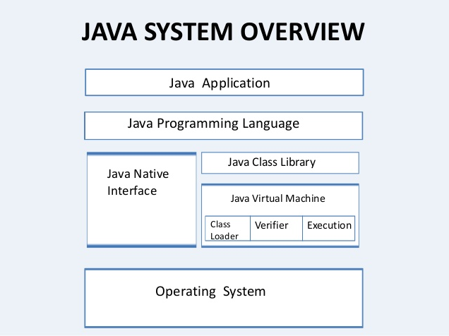

Slide 9
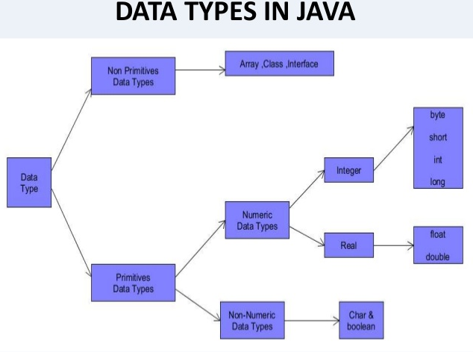

Slide 10
What is OOP?
Object-oriented programming is a method of implementation.
A language in which everything represent in the form of object is called object oriented programming language.
It not only makes the program less complex but also makes the software reuse feasible and possible.
Java is not truly object oriented programming language.

Slide 11
Concept of oop
Object
Class
Encapsulation
Inheritance
Polymorphism
Abstraction

Slide 12
Garbage collection
Garbage collection is the mechanism that De allocate the memory of an object when it is no longer referenced by a variable.
In c++, the memory of an object is released by use of delete operator.
Java virtual machine determines when to free up the memory of an object.

Slide 13
Advantages of java
java is simple language.
Java does not support POINTERS.
Java is first language in which programs can be executed using web.
Write once run anywhere(WORA).

Slide 14
Disadvantage on java
Slow performance.
No support for low level programming.
Poor features in java.
No control over Garbage collection.

Slide 15
Java virtual machine
Java virtual machine is the like usual computer which translate high level language into machine language.
Just like that java virtual machine also translate Bytecode into machine language.
JVM are available for many hardware and software plateform.

Slide 16
Simple java program
Class SampleOne
{
Public static void main(string args [])
{
System .out.println(“java is better than c++);
}
}

